Slide 1

Consuming RESTful Web Service
in your Xamarin.Forms application
Cedric Gabrang, Senior Mobile Applications Developers @ XAM Consulting

Slide 2


Slide 3

RESTful Web Service

Slide 4
RESTful Web Service
Definition
Web service is a standardized way or medium to propagate communication between the client and server applications on the World Wide Web.
REST is a way to access resources which lie in a server.

Slide 5
RESTful Web Service
Example
You could have a server that could be hosting a database with . All of these are an example of resources. If a client, say an application needs any of these resources, it must send a request to the server to access these resources. Now REST defines a way on how these resources can be accessed.

Slide 6
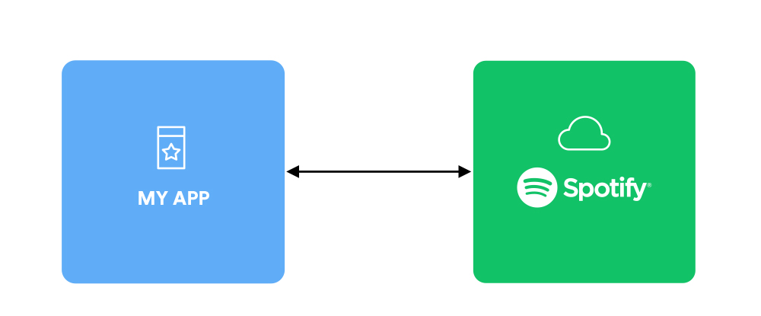
RESTful Web Service
Sample Illustration

Slide 7
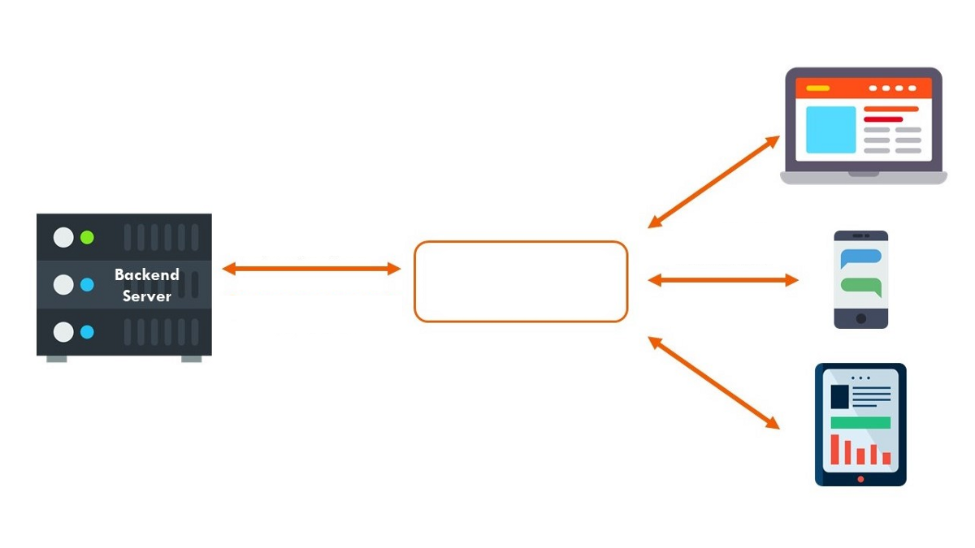
RESTful Web Service
Sample Illustration
Web service

Slide 8
RESTful Web Service
John W. Thompson
“
But what Web services suggest is that the connection is always there between an application that is resident somewhere in the cloud, and a user who is somewhere on the other end of a connection.

Slide 9
RESTful Web Service
Sample Web Service URL
https://api.jikan.moe/v3/search/anime?q=naruto&limit=5

Slide 10
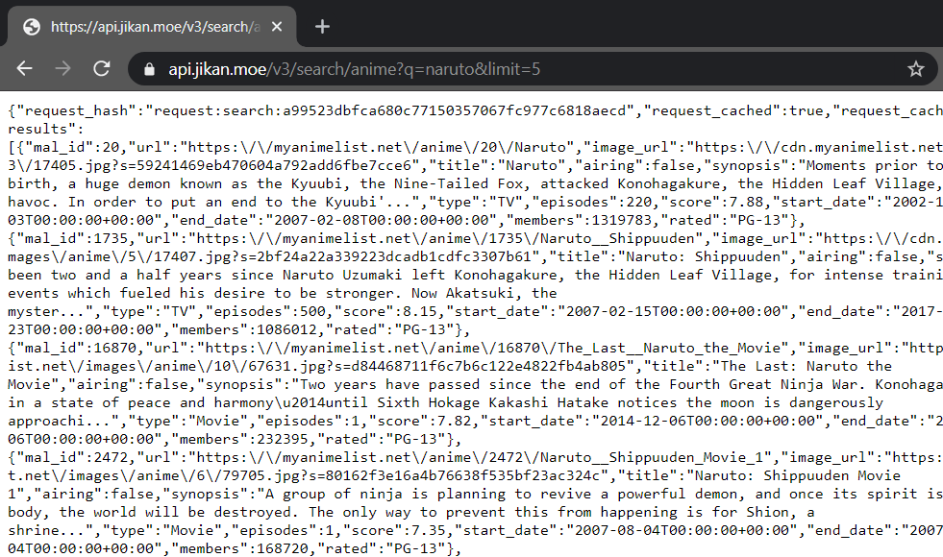
RESTful Web Service
Sample Web Service Response

Slide 11
What is JSON?

Slide 12

RESTful Web Service
What is JSON?
stands for JavaScript Object Notation
a lightweight data-interchange format
"self-describing" and easy to understand

Slide 13
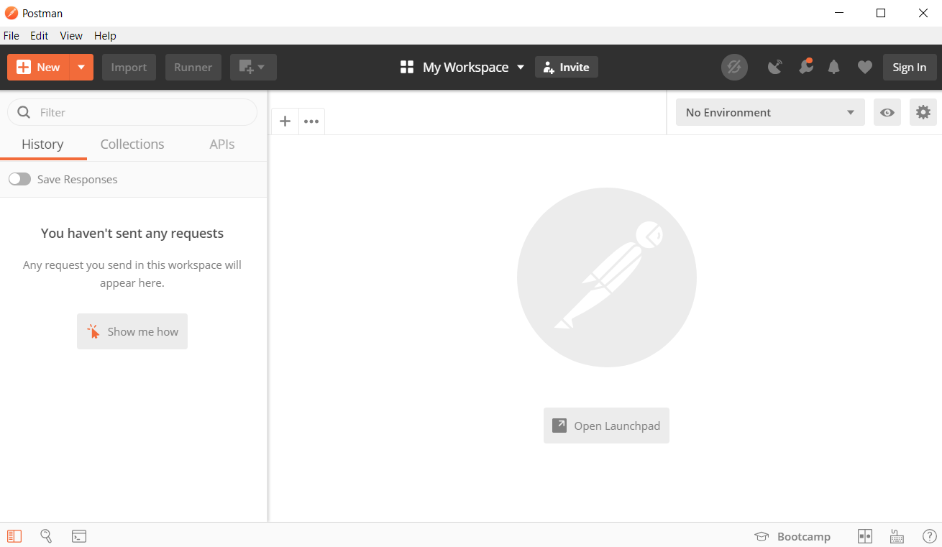
RESTful Web Service
Postman
https://www.postman.com/downloads/

Slide 14

RESTful Web Service
Code Sample
Namespace: System.Net.Http Provides a base class for sending HTTP requests and receiving HTTP responses from a resource identified by a URI.

Slide 15
RESTful Web Service
Code Sample
Represents a HTTP response message including the status code and data.
Send a GET request to the specified Uri as an asynchronous operation.

Slide 16
RESTful Web Service
Code Sample

Slide 17
Xamarin.Essentials
https://docs.microsoft.com/en-us/xamarin/essentials/

Slide 18
Thank you!
Shoot your Questions!
Cedric Gabrang, Senior Mobile Applications Developers @ XAM Consulting

